Slide 1



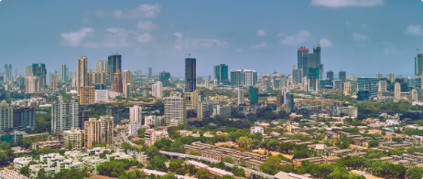


https://www.linkedin.com/in/swapnil-chavan-365950205
Comprehensive Analysis of Mumbai's Property Market
This comprehensive analysis delves into the vibrant real estate landscape of Mumbai, leveraging a robust dataset to uncover key insights and trends. From the diverse distribution of property types across cities to the intriguing relationship between the number of bedrooms and price per square foot, this report offers a multifaceted exploration of the Mumbai property market.
by swapnil chavan
chavanswapnil0990@gmail.com

Slide 2
Distribution of Property Types Across Cities
Central Mumbai Suburbs
Mira Road And Beyond
Other Cities
The data reveals that Central Mumbai Suburbs has the highest count of properties, predominantly residential apartments, with a peak count of 302 for residential apartments and a much smaller count of 6 for studio apartments.
Mira Road And Beyond and Mumbai Andheri-Dahisar show a significant number of residential apartments with counts of 101 and 131 respectively, but very few studio apartments.
Other cities like Mumbai Harbour, Mumbai South West, South Mumbai, and Thane also show a presence of properties but with lower counts compared to the aforementioned cities.

Slide 3

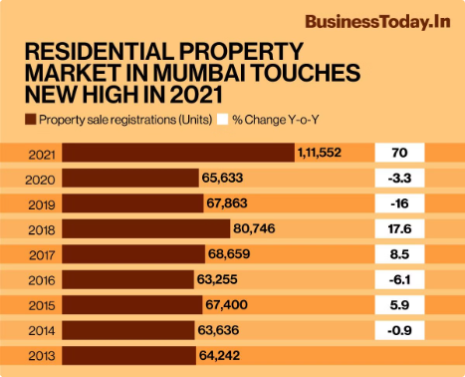
Variations in Average Price per Square Foot
1
Highest Average Price
Mumbai Harbour stands out with the highest average price per square foot at approximately 49,752.60.
2
Lowest Average Price
Mumbai Beyond Thane has the lowest average price per square foot, recorded at 9,378.98.
3
Considerable Variation
There is a substantial range in pricing, from the lowest in Mumbai Beyond Thane to the highest in Mumbai Harbour, indicating a diverse real estate market across different regions.

Slide 4

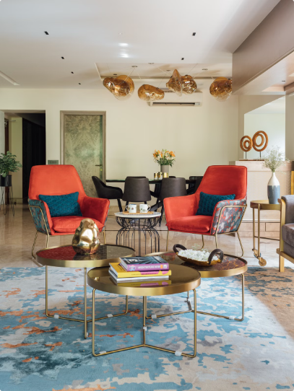
Relationship Between Bedrooms and Price per Square Foot
Correlation Value
The correlation coefficient of 0.121741 suggests a very weak positive correlation between the number of bedrooms and the price per square foot.
Interpretation
The very weak positive relationship implies that other factors might be more influential in determining the price per square foot than just the number of bedrooms.
Conclusion
There is a very weak positive relationship between the number of bedrooms and the price per square foot, suggesting that other factors play a more significant role in property pricing.

Slide 5

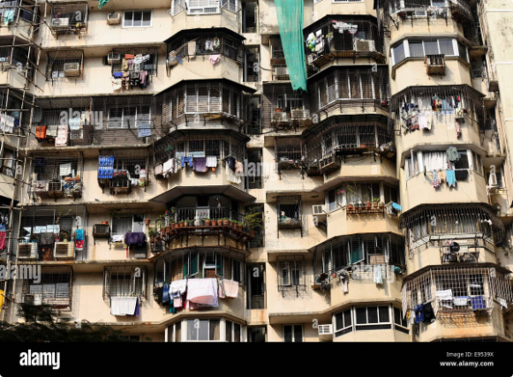

Average Age of Properties Across Cities
5 Years
The average age of properties in Central Mumbai suburbs, Mira Road And Beyond, Mumbai Andheri-Dahisar, Mumbai Beyond Thane, and Mumbai Harbour is 5 years.

Slide 6

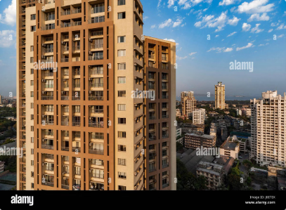
Impact of Building Height on Price per Square Foot
1
Increasing Trend
There is a clear increasing trend in the price per square foot as the total number of floors in a building increases, suggesting that higher buildings tend to have a higher price per square foot.
2
Lowest Price
The lowest average price per square foot is observed in buildings with 0-10 floors, at 12,655.29.
3
Highest Price
The highest average price per square foot is found in buildings with more than 70 floors, reaching up to 73,137.56.

Slide 7

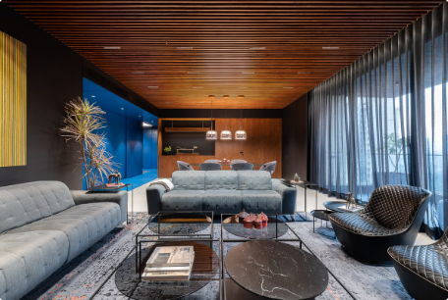
Furnishing Status Distribution
Semi-furnished
The most common furnishing status, with a total of 865 properties. This category significantly outnumbers the other types of furnishings.
Custom furnished
Represents a smaller segment with only 55 properties, suggesting a niche market or specialized preference.
Fully furnished
The least common with only 7 properties available, indicating a very limited market presence or demand for fully furnished properties.

Slide 8
Price Differences Between Property Classes
Class A Properties
Class B Properties
Price Difference
The average price per square foot for Class A properties is 34,406.5.
The average price per square foot for Class B properties is 26,465.8.
There is a significant difference of 7,940.7 per square foot between Class A and Class B properties, with Class A being more expensive.

